Slide 1
16 February, 2026
Chittagong University of Engineering and Technology
Department of Electrical and Electronic Engineering
Electrical Services Design For A Library With Archival Environmental Control
Course Code: EEE 460
Course Name: Electrical Service Design Group: 12
Presented by :
Udhay Chowdhury
ID: 2002015
Muhammad Salman Asif
ID: 2002031
Efaz M. Afnan Feroz
ID: 2002034

Slide 2
Overview
01
Objectives
06
Load Calculation
02
Codes and Standard Used
07
Bill of Quantities
03
Drawing: Layout and Conduits
08
Total Cost
04
Single Line Diagrams
09
Conclusion
05
Earthing System Design
10
Question & Answers

Slide 3
Objectives
Design a code-compliant LV distribution system for the Library and Archival Vault complex
Implement backup power strategy with ATS and UPS systems for critical loads
Provide comprehensive documentation including layouts, SLDs, load calculations, and BOQ

Slide 4
Codes and Standards Used
BNBC 2020 (Bangladesh National Building Code) – Part 8: Building Services (Electrical).
BS 7671 (IET Wiring Regulations) – For cable sizing, circuit protection, and earthing requirements.
NFPA 72 (National Fire Alarm and Signaling Code) – For dedicated fire alarm circuit requirements.
IEEE 802.3af/at (Power over Ethernet Standards) – For IP Camera and Network Switch power delivery

Slide 5
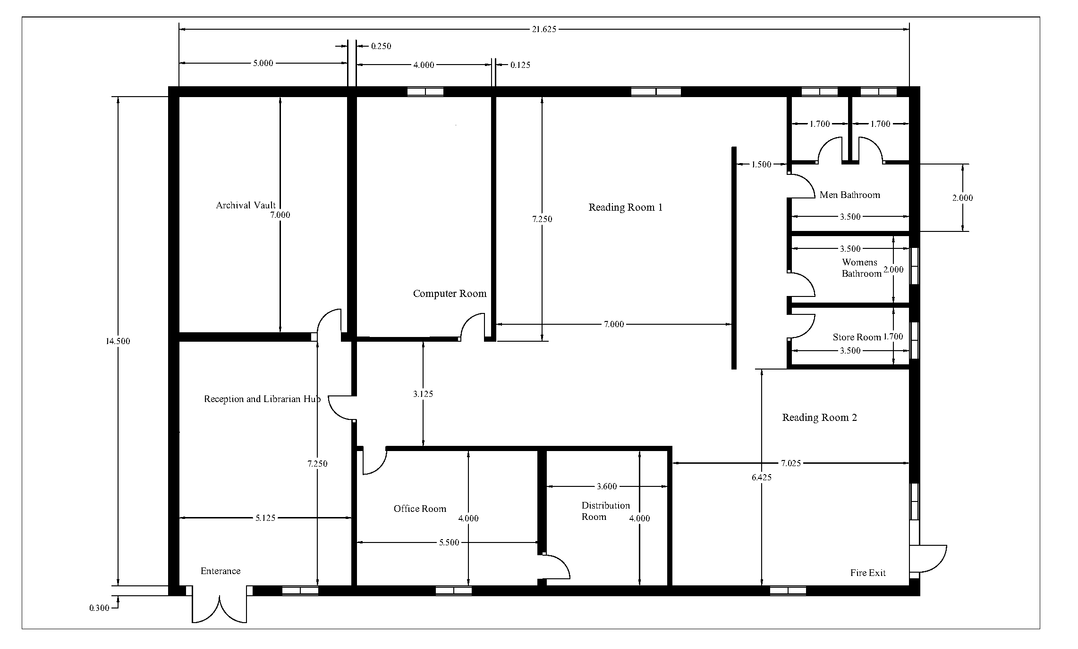
Drawings: Layouts and Conduits
Figure 01: Architectural Floor Plan with Dimensions

Slide 6
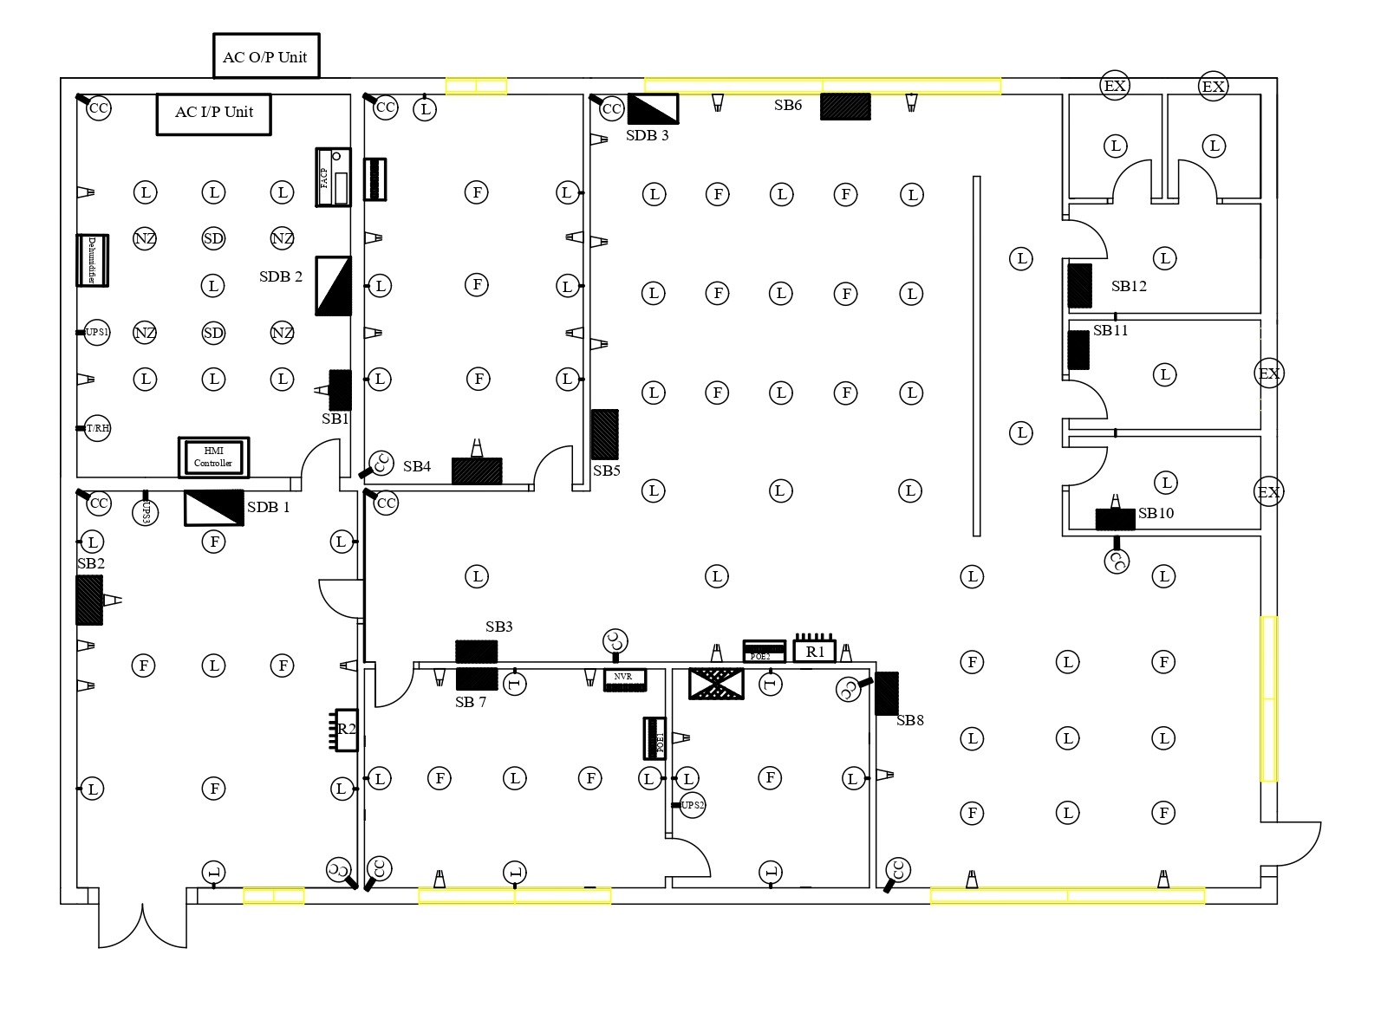
Drawings: Layouts and Conduits
Figure 2: Fitting Layout: Placement of Lights, Fans, and Components.

Slide 7
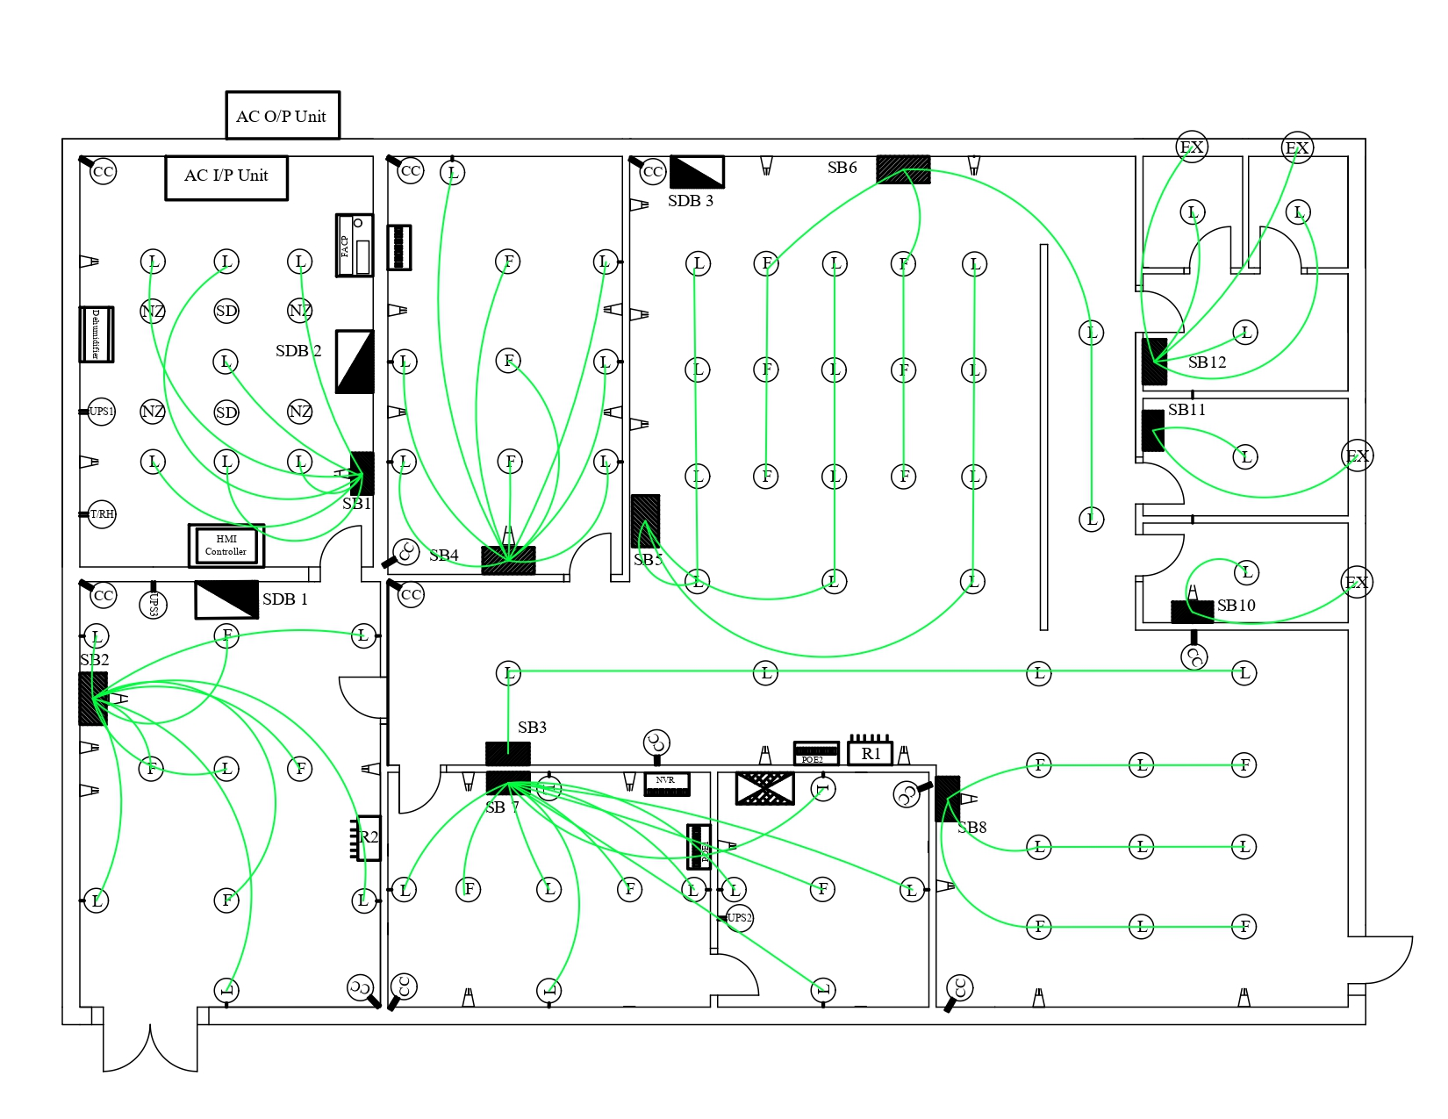
Drawings: Layouts and Conduits
Figure 3: Conduit Layout: Final Circuits (Switchboards to Lights/Fans).

Slide 8
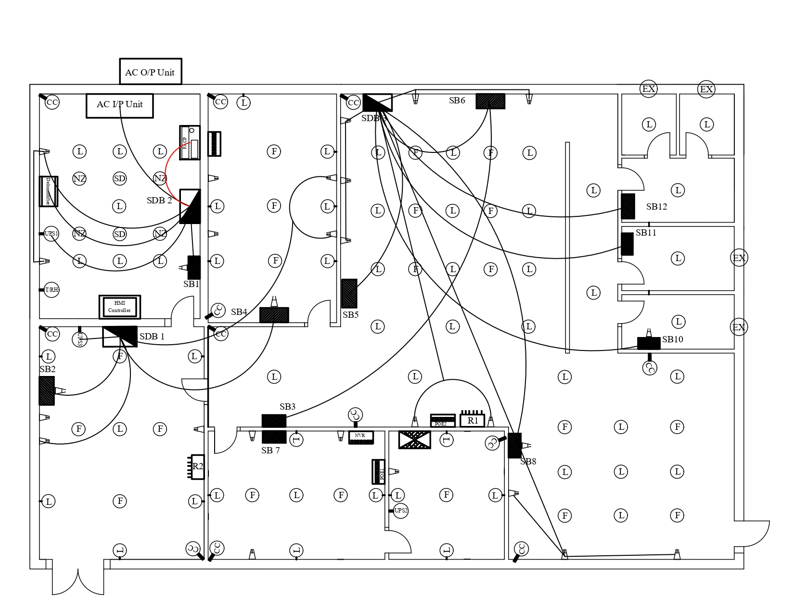
Drawings: Layouts and Conduits
Figure 4: Conduit Layout: SDB to Switchboard Connections.

Slide 9
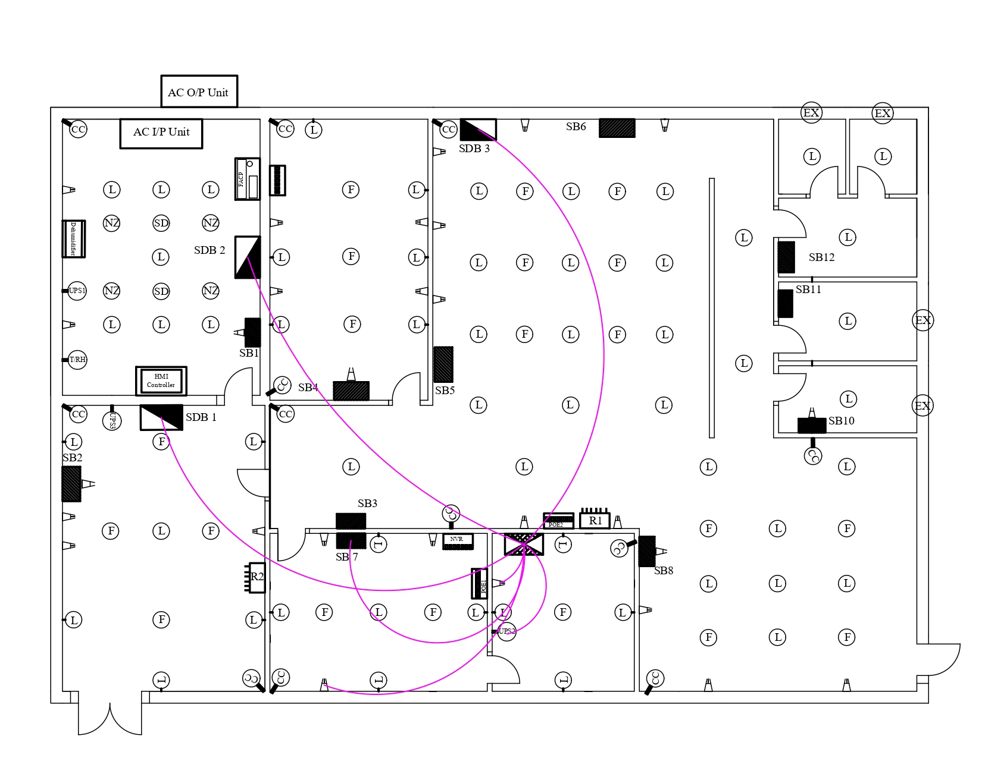
Drawings: Layouts and Conduits
Figure 5: Conduit Layout: Main Distribution Routes (MDB to SDBs).

Slide 10
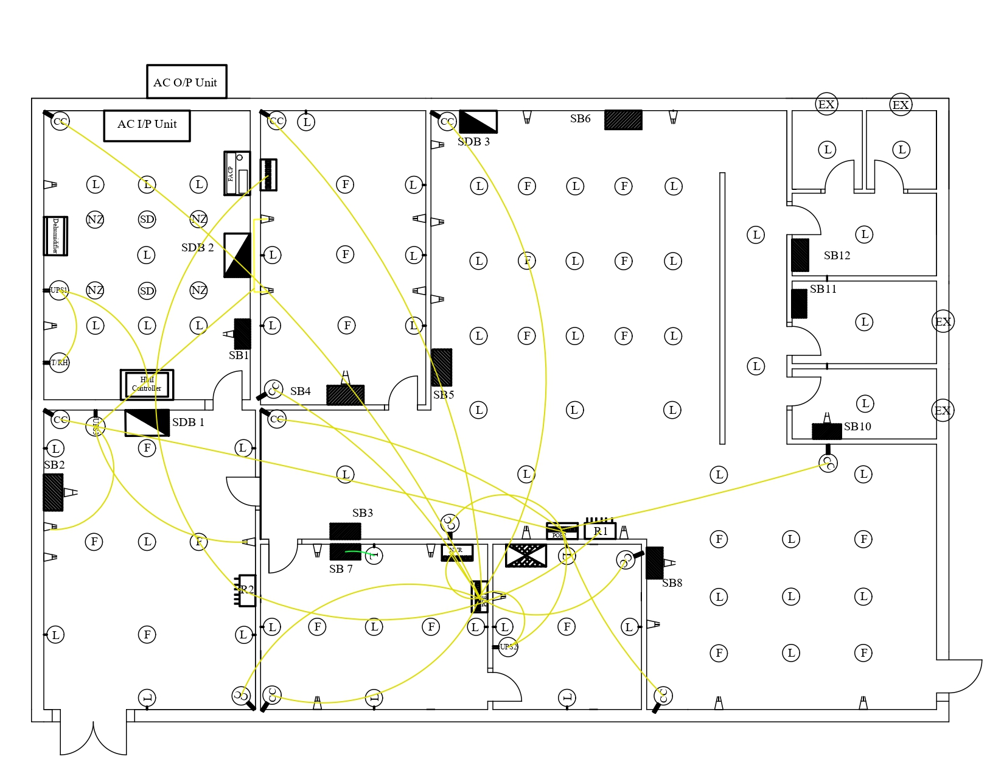
Drawings: Layouts and Conduits
Figure 6: Conduit Layout: UPS to CCTVs

Slide 11
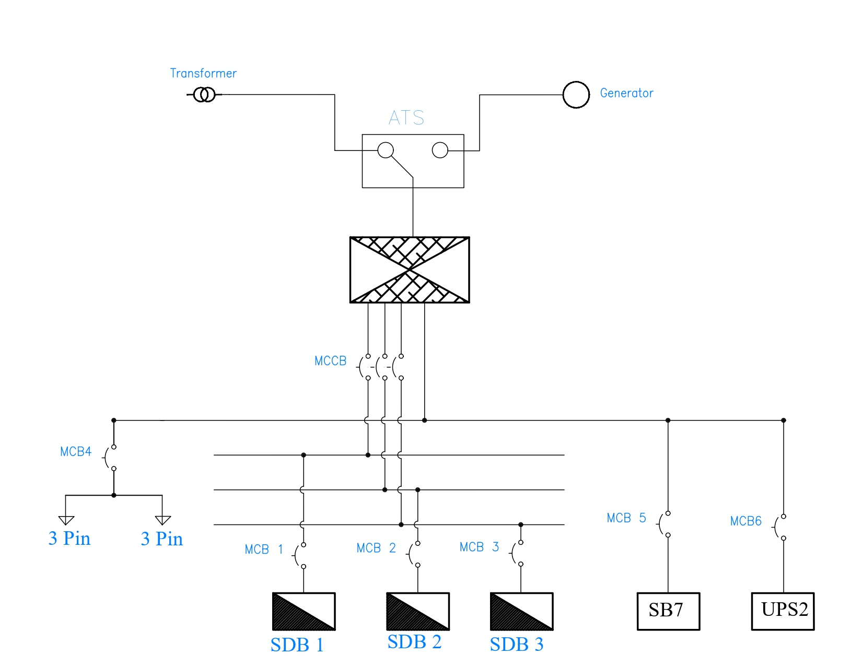
Single Line Diagram (SLDs)
Figure 7: Utility/Generator Intake, ATS, MDB, and Feeders

Slide 12
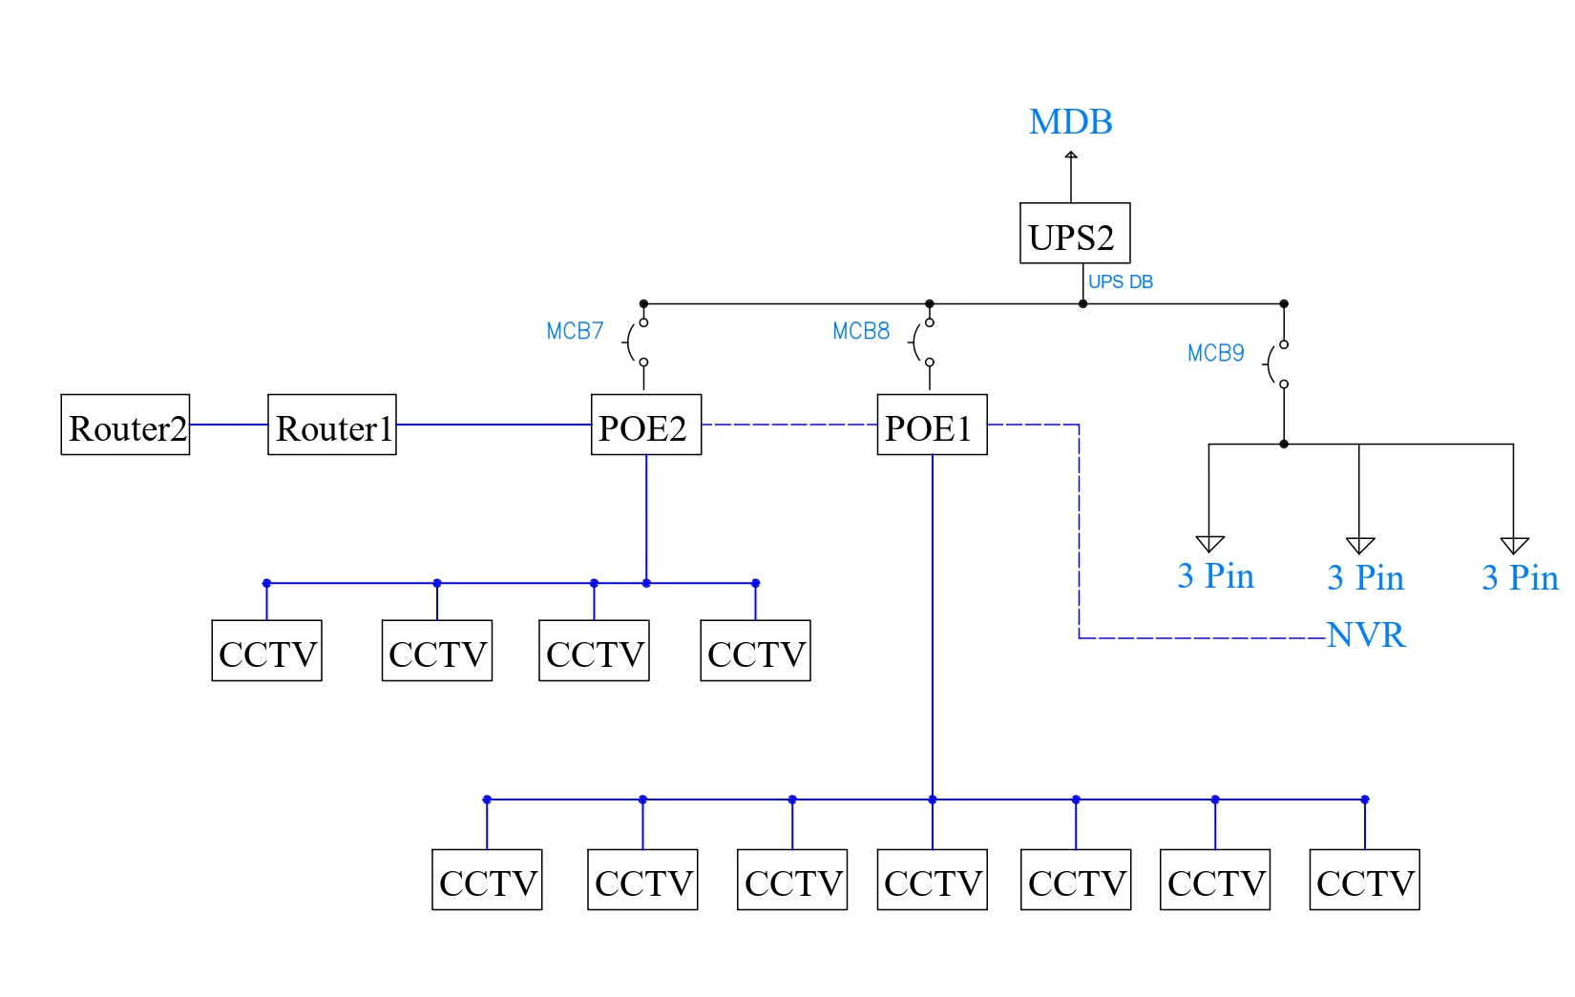
Single Line Diagram (SLDs)
Figure 8: SLD: UPS 2 Distribution and CCTV Network (PoE).

Slide 13
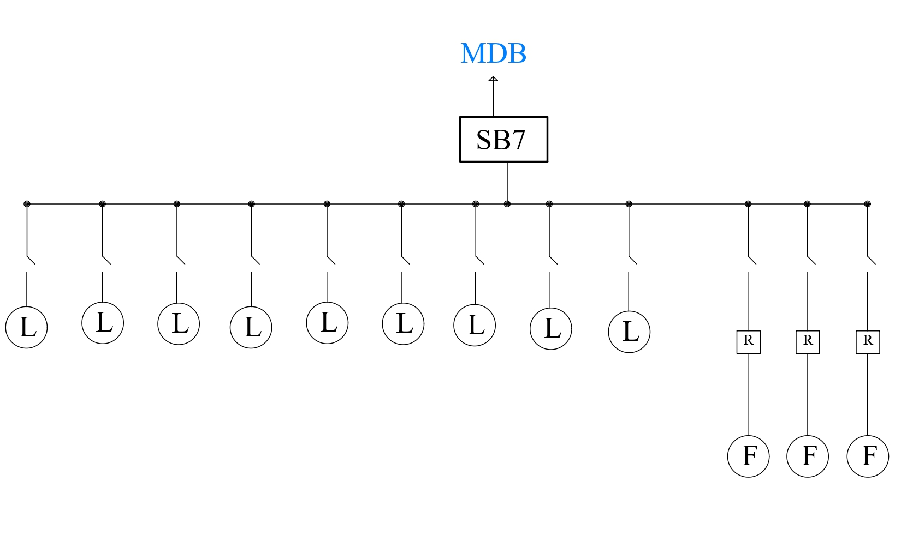
Single Line Diagram (SLDs)
Figure 9: Office Room Switchboard (SB7).

Slide 14
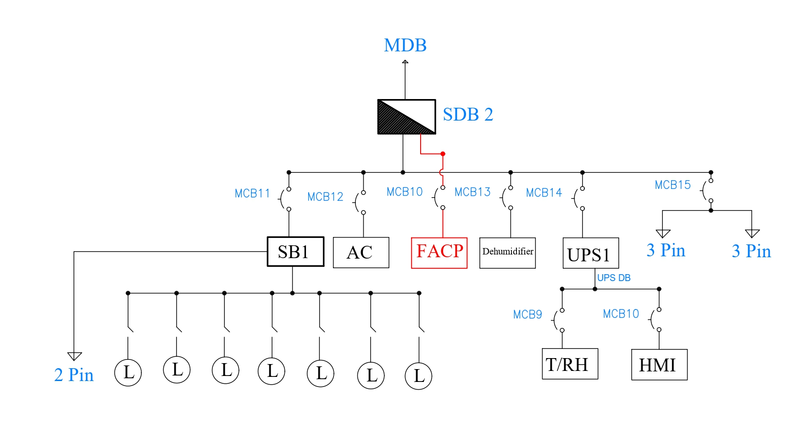
Single Line Diagram (SLDs)
Figure 10: Archival Vault Distribution (SDB 2) & Critical Controls.

Slide 15
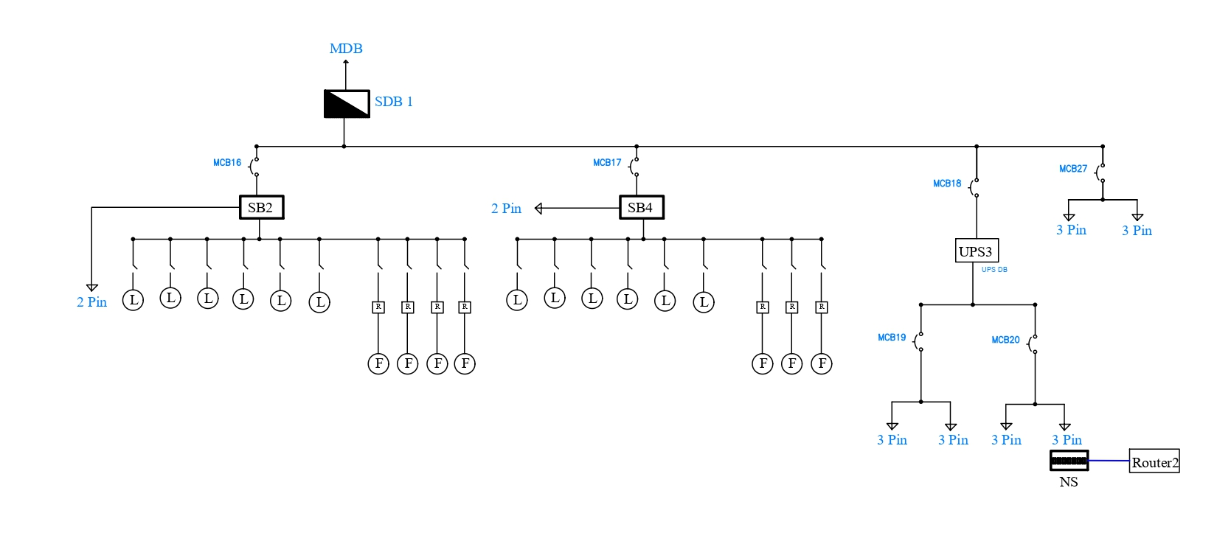
Single Line Diagram (SLDs)
Figure 11: SDB 1 (Reception, Librarian Hub, Computer Room

Slide 16
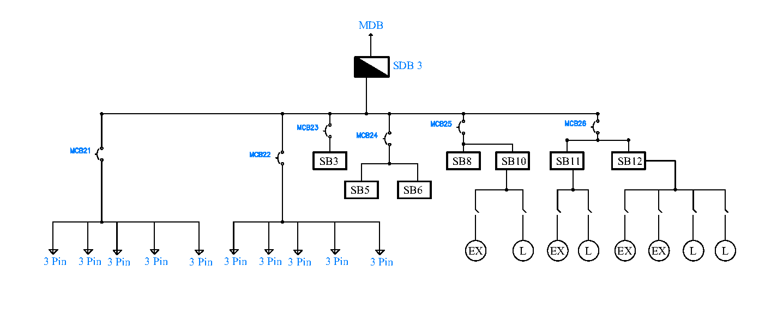
Single Line Diagram (SLDs)
Figure 12: SLD: SDB 3 Feeding Reading Room Switchboards.

Slide 17
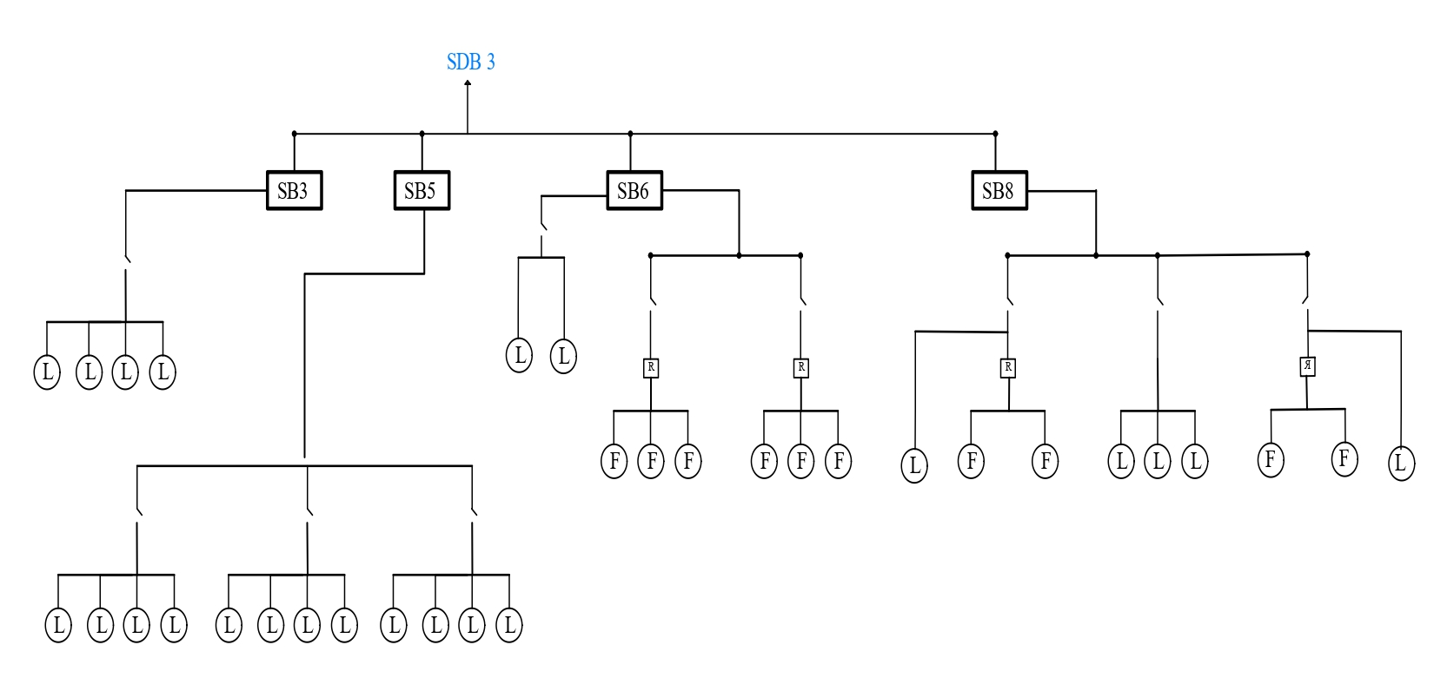
Single Line Diagram (SLDs)
Figure 13: Office Switchboard (SB7) Connection

Slide 18
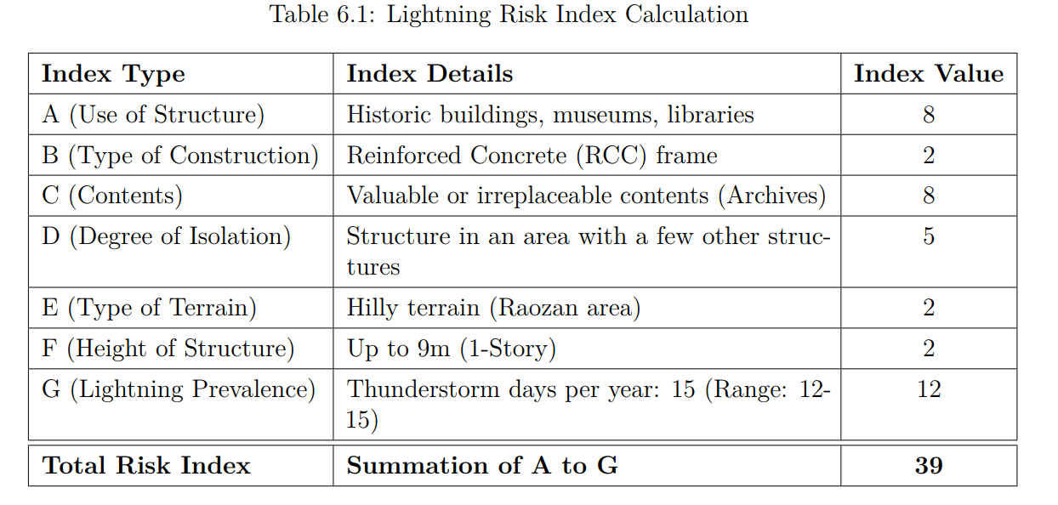
Lightning Risk Assessment (BNBC 2020)
Total Risk Index<40 .
Lightning Protection System is not mandatory .
A basic protection system is recommended as a safety precaution.

Slide 19
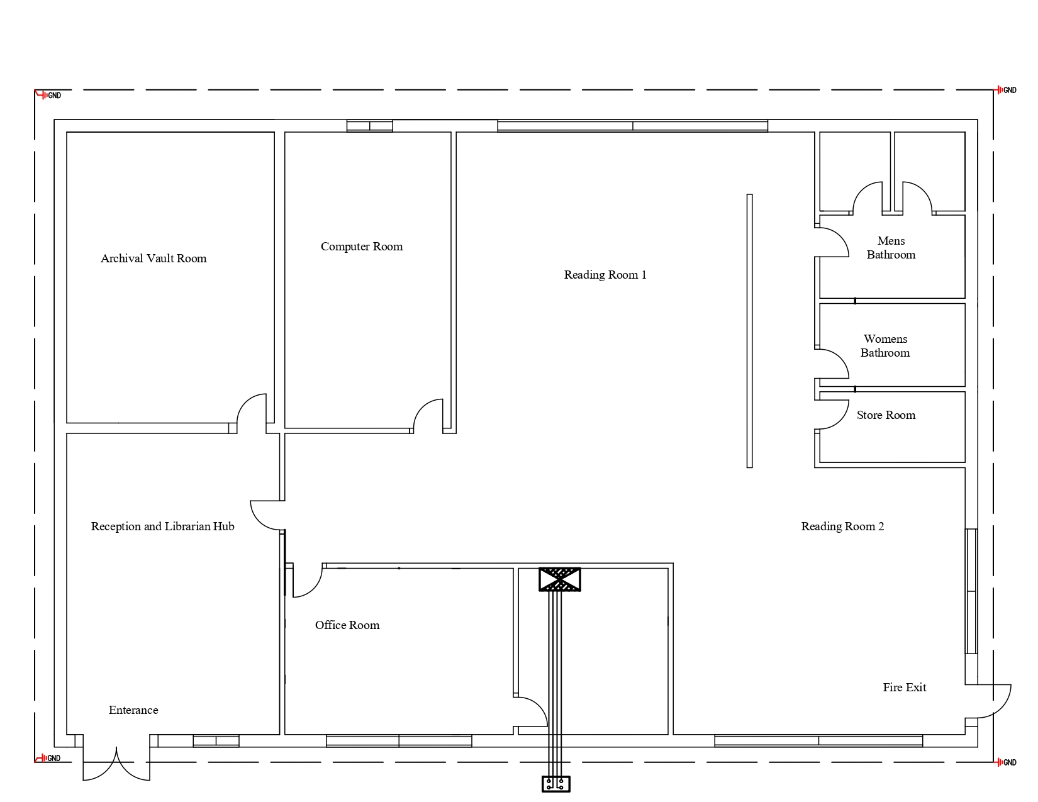
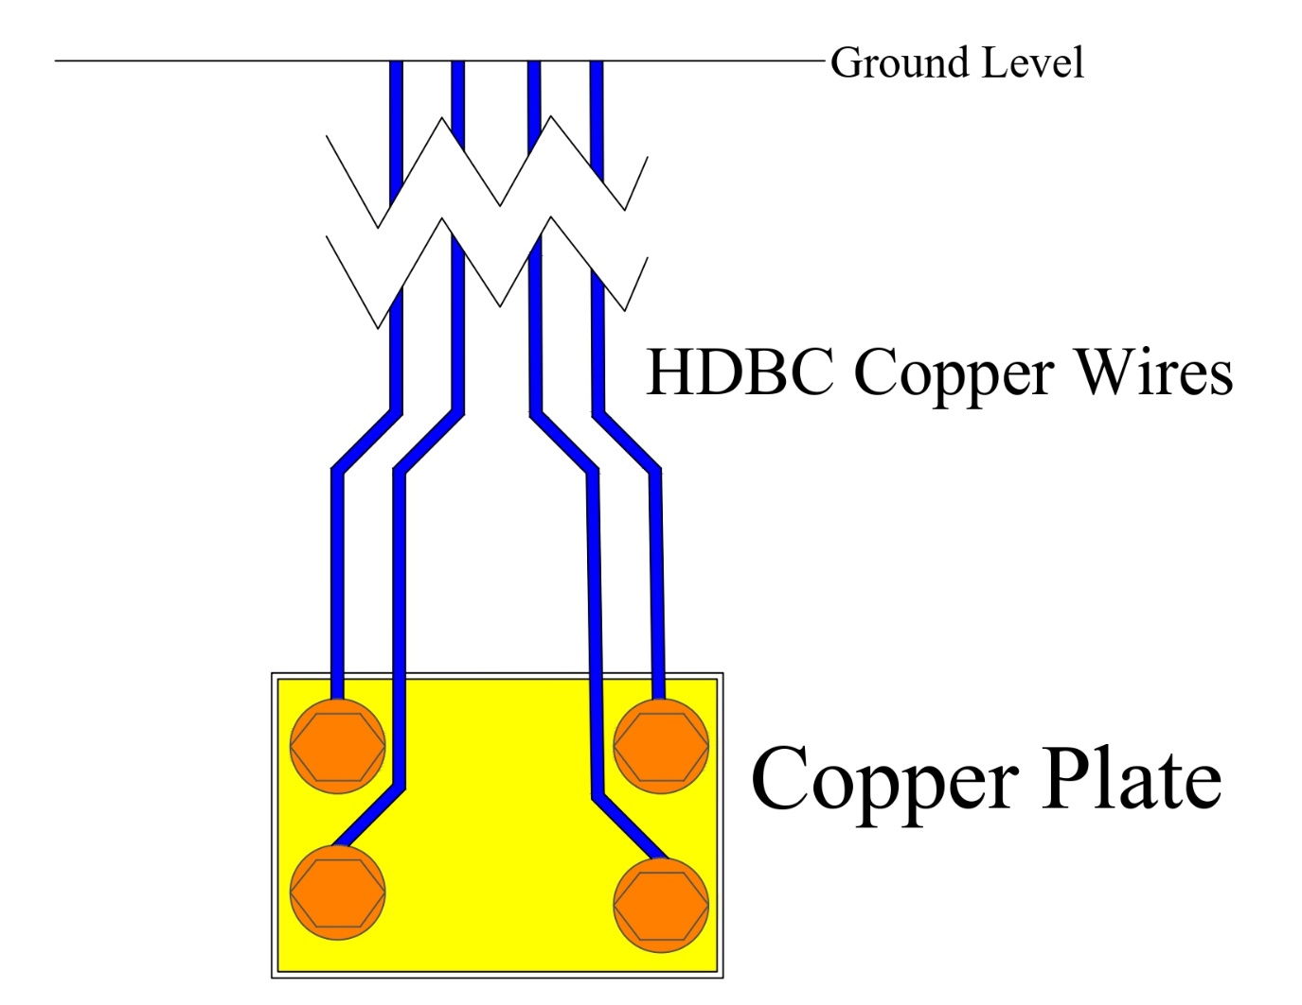
Earthing System Design
Figure 14: (a) Copper Plate Earthing (b) Earthing Layout

Slide 20
Load Calculation
Assumptions & Design Parameters:
Voltage: 220V single-phase, 50Hz Power Factor: 0.8
Diversity Factors: Lighting = 0.7, General Sockets = 0.8, Dedicated Sockets = 1.0
Wiring:
PVC conduit concealed wiring
Copper BYM (Phase/Neutral), BYA (Earth)
1.5 mm² for lighting/fans, 2.5 mm² for sockets
HDBC main earthing to MEB

Slide 21
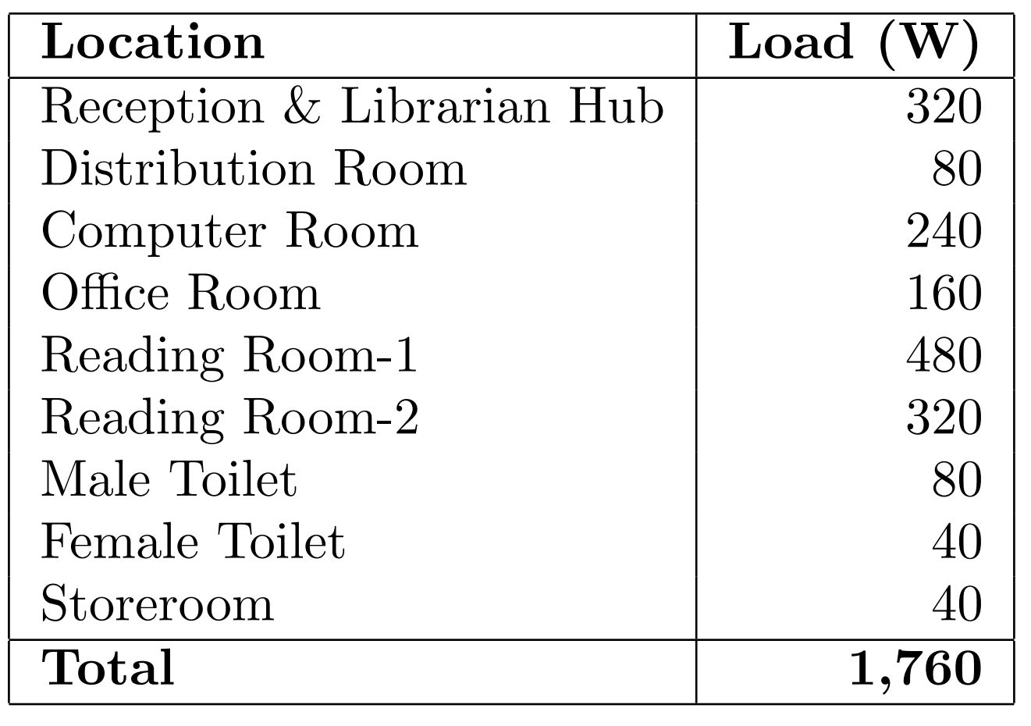
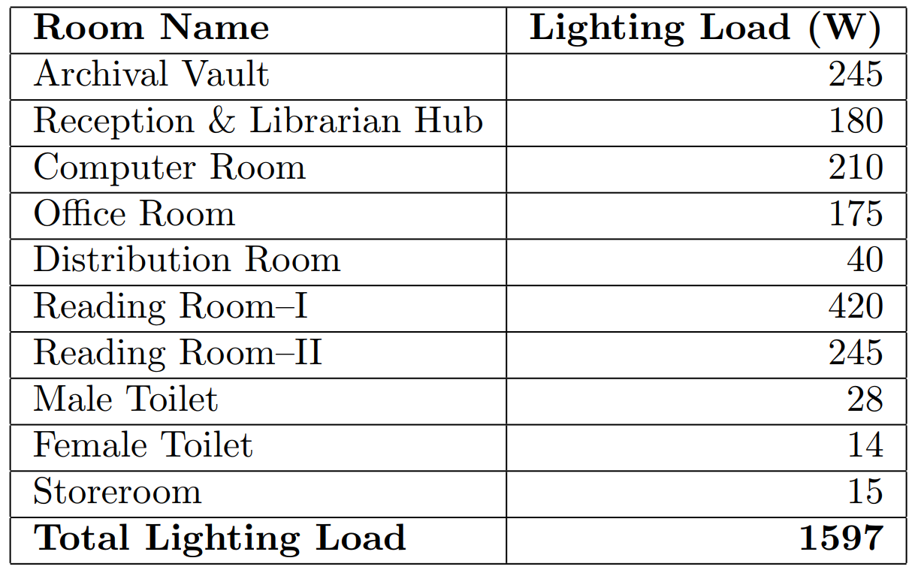
Load Calculation
Room Areas & Lighting Load Calculation
Room Areas & Fans Load Calculation

Slide 22
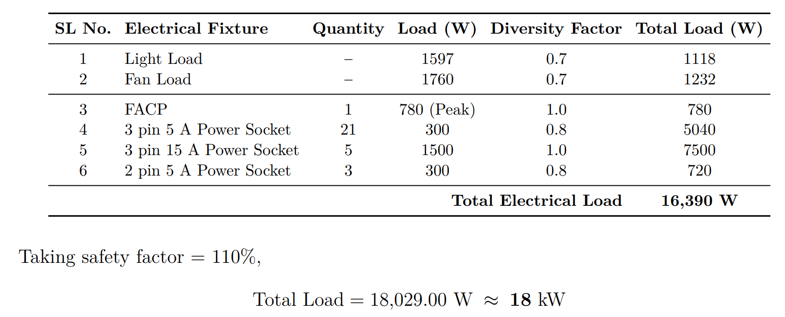
Total Load Calculation
Overall Load Summary

Slide 23
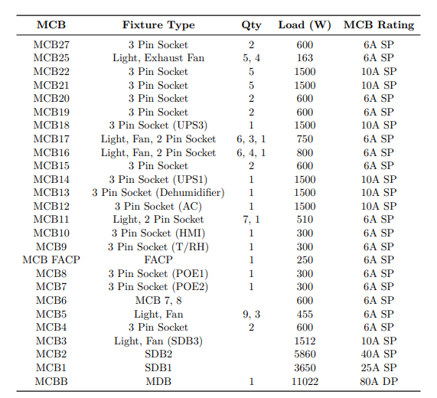
Circuit Breakers Ratings

Slide 24
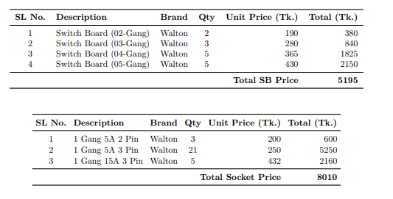
Bill of Quantity
Light Estimation
Fan Estimation
Description | Wattage | Quantity | Unit Price (Tk.) | Total Price (Tk)
Click Rocket LED Bulb (B22) | 35 | 37 | 740 | 27380
Walton Public Series A-30W (B22/E28) | 30 | 6 | 700 | 4200
Walton Public SeriesA-15W (B22) | 15 | 1 | 300 | 300
Walton Public SeriesA-9W (B22) | 9 | 4 | 230 | 920
Walton WLED-HP7WB22 | 7 | 6 | 300 | 1800
Total |  |  |  | 34600
Type | Description | Quantity | Unit Price (Tk.) | Total Price (Tk)
Ceiling Fan (F) | VISION Super Ceiling Fan Ivory 56" 80W | 20 | 3750 | 75000
Exhaust Fan | VISION Exhaust Fan 10" 40W | 4 | 1150 | 4600
Switch Socket

Slide 25
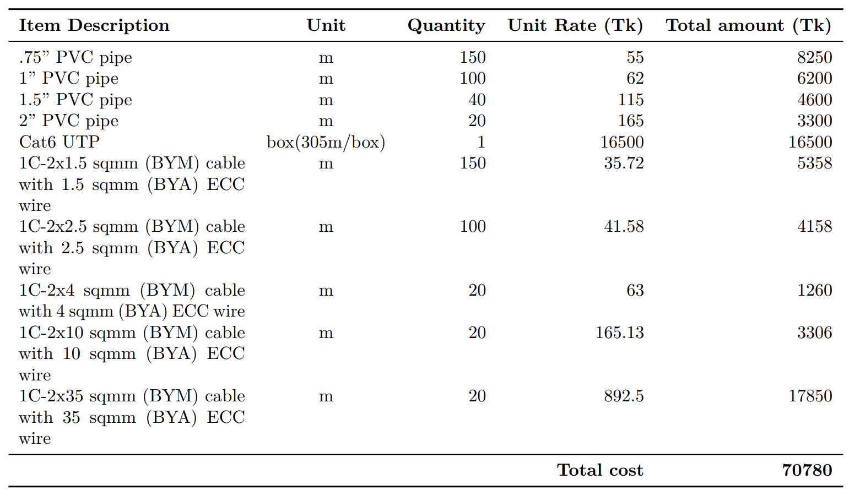
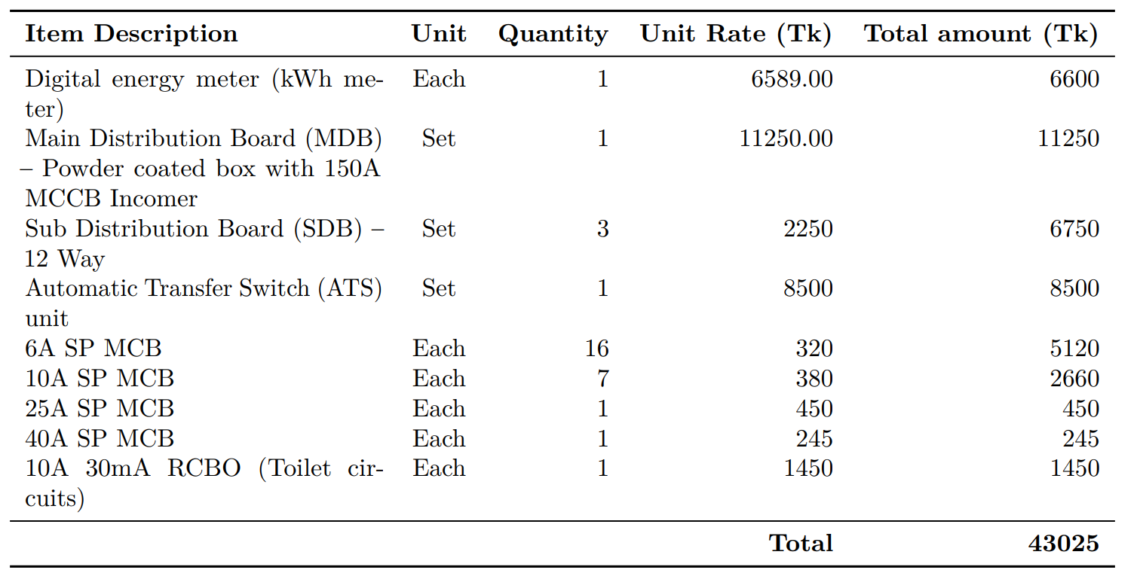
Bill of Quantity
Conduit & Wiring Estimation
Distribution Boards & Protection

Slide 26
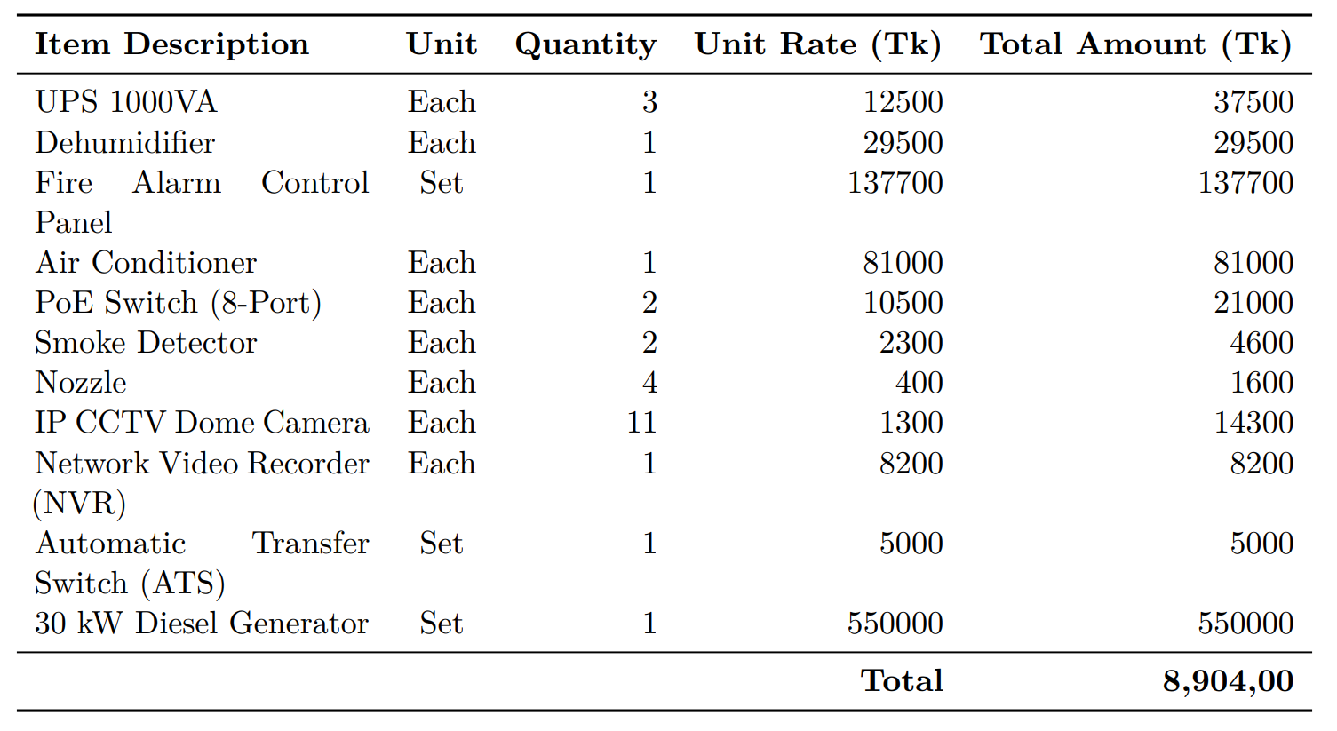
Bill of Quantity
Critical Systems

Slide 27
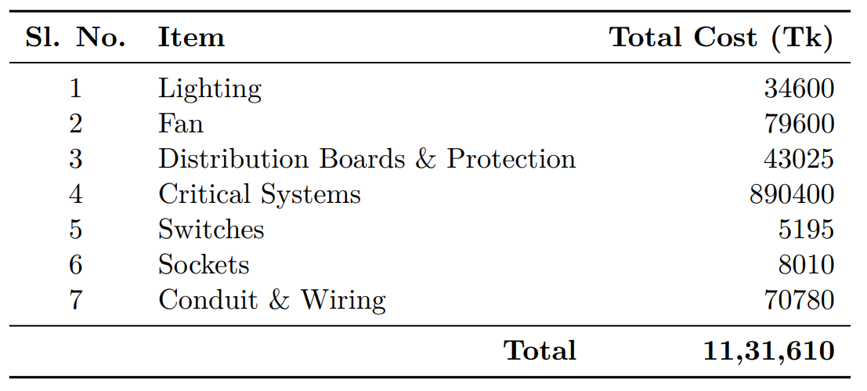
Total Electrical Estimated Cost

Slide 28
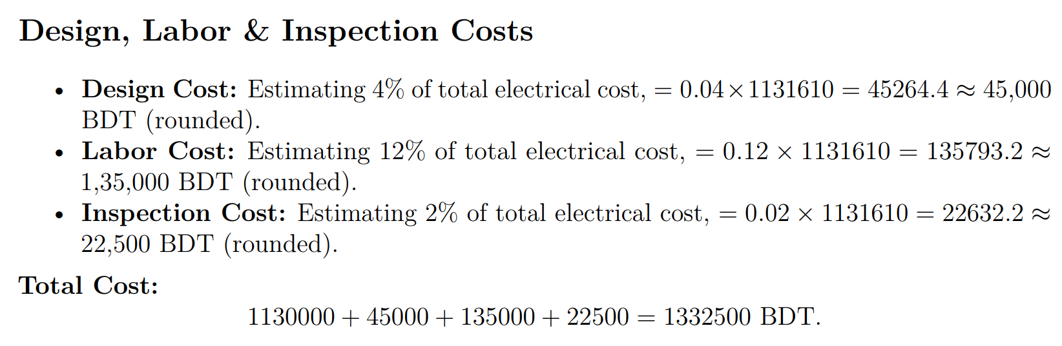
Total Cost

Slide 29
February 2026
Thank You
Presented by :
Udhay Chowdhury
ID: 2002015
Mohammad Salman Asif
ID: 2002031
Efaz M. Afnan Feroz
ID: 2002034

Slide 30
February 2026
Any Questions Or Suggestions?
Presented by :
Udhay Chowdhury
ID: 2002015
Mohammad Salman Asif
ID: 2002031
Efaz M. Afnan Feroz
ID: 2002034

